Slide 1
Technical Details of Tribe Problem

Slide 2
Current Model(Please convey this info through some graphics you can find for these models online)
N-gram from words across languages. Logistic regression with n-grams to predict classes.
To Predict – Brand Classification(Binomial), Multi-label classification(multinomial)
DIFFICULTIES
Creating n-grams is cumbersome and inefficient particularly in unknown languages.
Two-label prediction improvement mainly in Asian languages(Promised 95% to clients, achieve in the range of 80-93%)
Multi-label prediction across languages is difficult – more training data in each new language(cost of labeling data), potential cost of translation, word sense disambiguation(Kate for instance could mean brand or name)
IMPORTANT IDEAS : Transfer Learning, Active learning, Latent Space Representation(Encoding).

Slide 3
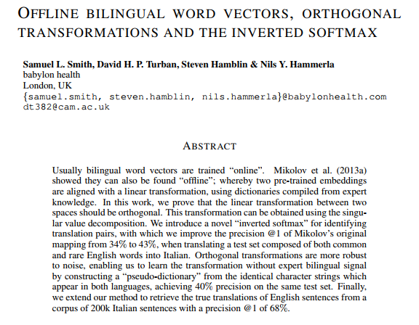
ADVANTAGES Pre-Trained, code and embeddings available open-source- Can be trained for new languages(FB recently trained this for 204 languages through social media, Wiki data). Works with any classifier/ any future task.

Slide 4
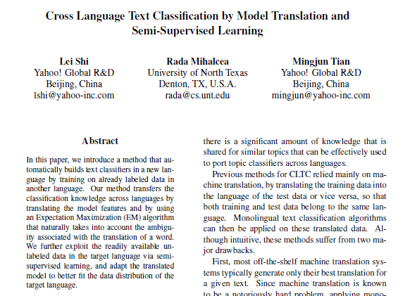
ADVANTAGES No need of machine translation – labeled data in source and semi supervised feedback in target, EM used to pick and match distributions in target space.

